Slide 1
Developing with Node.js and Visual Studio Code
Notes:
This module introduces students to developing software projects using Node.js and Node Package Manger (npm). Students will learn to use npm together with Visual Studio Code to manage software projects and to install external packages. The module explains how to configure a new project with support for TypeScript and how to add the packages for typed definition files for popular JavaScript libraries such as jQuery. The module demonstrates configuring a project with a local web server to test and debug project files using the HTTP protocol. The module introduces students to Gulp and demonstrates how to write and run Gulp tasks to automate developer tasks such as compiling TypeScript into JavaScript and starting up a debugging session. The module concludes by examining Webpack and teaching students how to use Webpack to bundle a project's source files into a single file for distribution.

Slide 2
Agenda
Introduction to Node.JS and NPM
Installing and Updating Packages in Visual Studio Code
Adding TypeScript Support to a Node.js Project
Configuring Node.js with Server-side Debugging Support
Using Gulp to Automate Running Development Tasks
Developing Projects using Webpack

Slide 3
Cross-platform Toolchain
Node.js
Node Package Manager (npm)
TypeScript
Gulp
Webpack

Slide 4
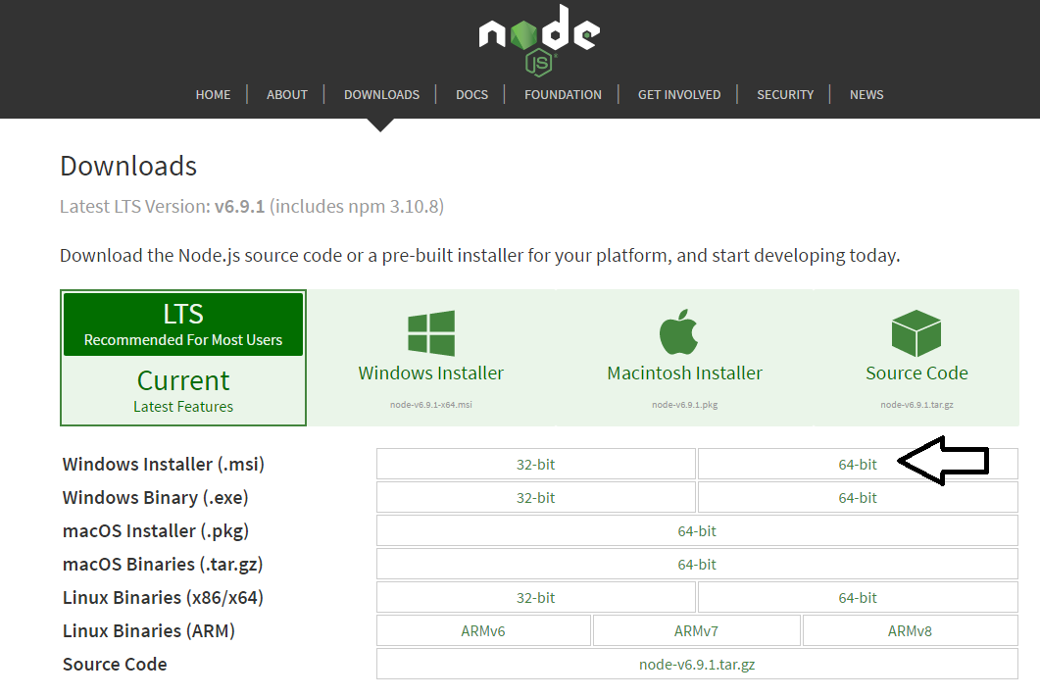
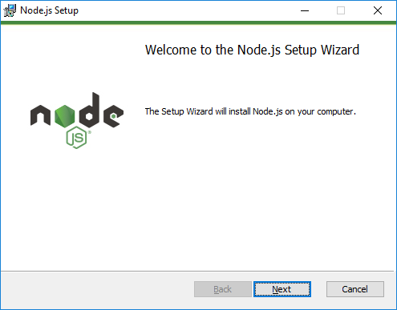
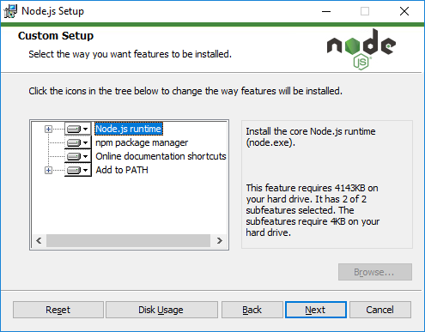
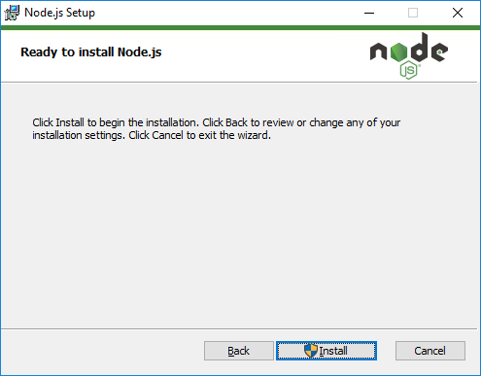
Installing node.js
https://nodejs.org/en/download/

Slide 5
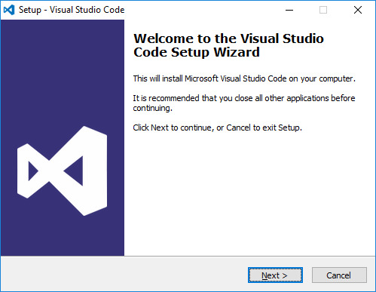
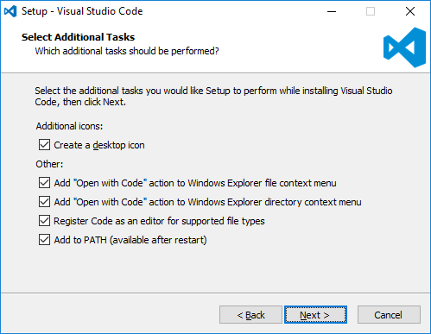
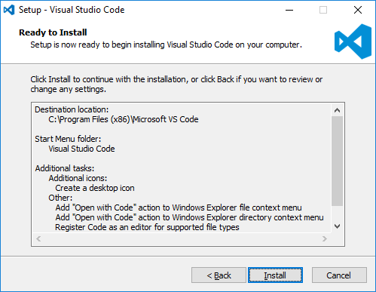
Install Visual Studio Code
http://code.visualstudio.com/

Slide 6
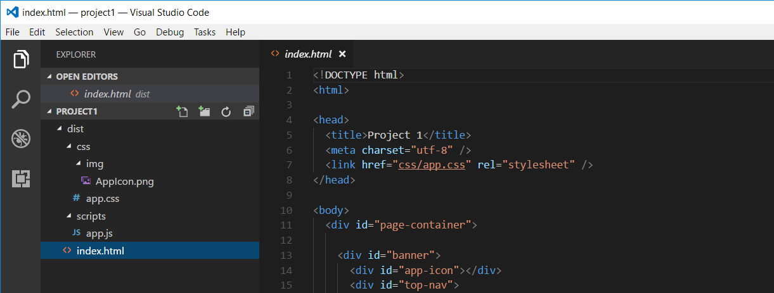
Developing with Visual Studio Code
Node.js is agnostic when it comes to developer IDE
There are many different IDEs that people use with Node.js
This course will be using Visual Studio Code
Visual Studio is not a good fit for Node.js development
Visual Studio solution & project files incompatible with Node.js

Slide 7
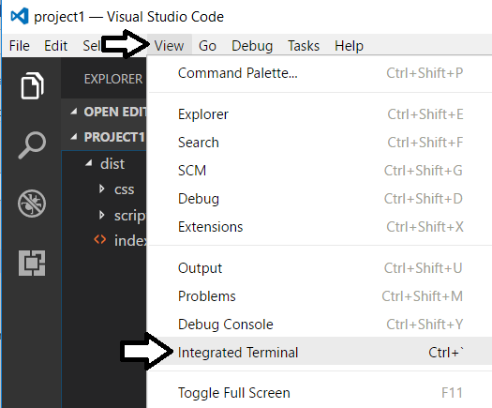
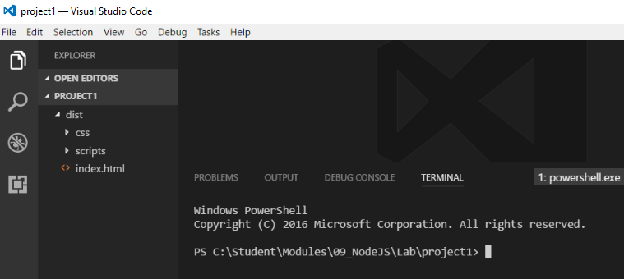
Integrated Terminal
Use the Integrated Terminal to execute npm command

Slide 8
Agenda
Introduction to Node.JS and Visual Studio Code
Installing and Updating NPM packages
Configuring Server-side Debugging Support
Node.JS Development with TypeScript
Using Gulp to Automate Running Tasks
Bundling the Source Files using WebPack

Slide 9
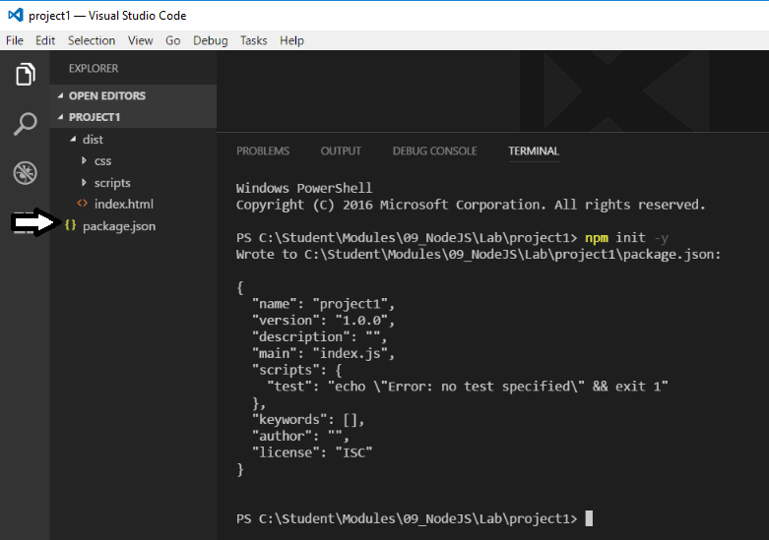
npm init
Node.js projects initialized with npm init command
This command created the package.json file

Slide 10
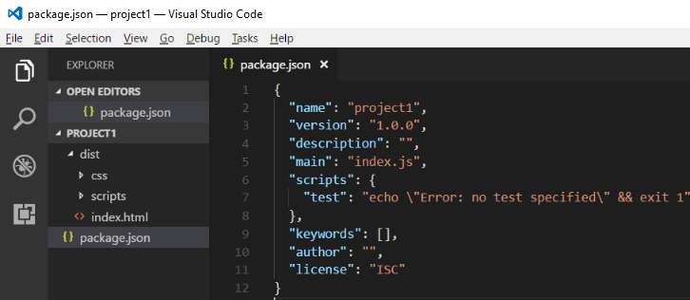
package.json
package.json serves as project manifest file
Tracks project name and version number
Tracks installed package dependencies

Slide 11
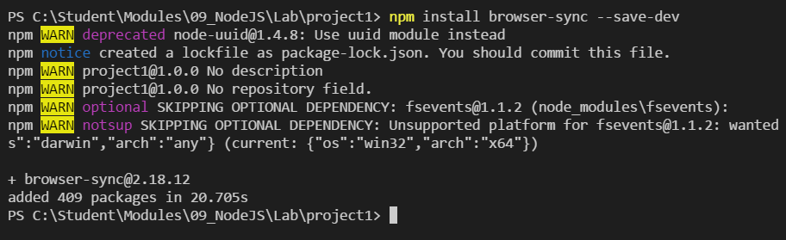

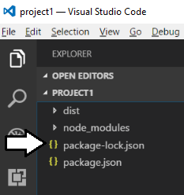
Installing Packages

Slide 12
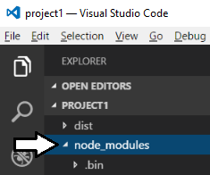
node_modules folder
Package files copied into node_modules folder
This folder often contain 100s of packages for a project
Contents of folder not saved into source control
Contents can be restored with npm install command

Slide 13
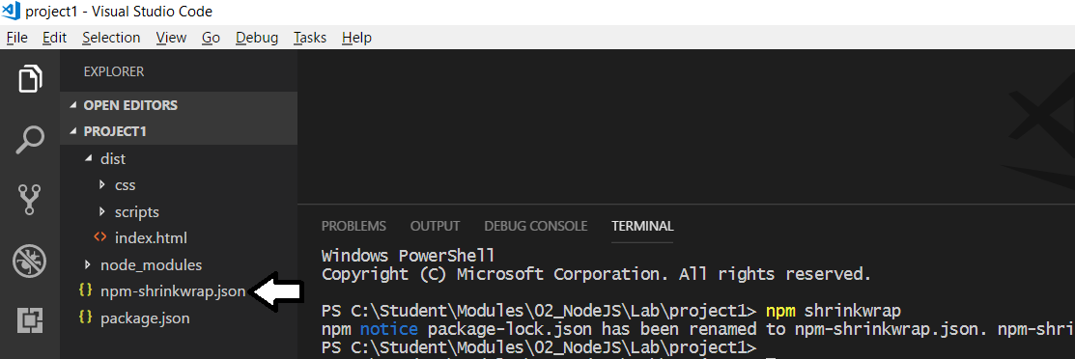
package.lock.json vs npm.shrinkwrap.json
npm generates files to track changes to node-modules
package.lock.json file initially created when installing packages.
package.lock.json file should not be checked into source control
Running npm shrinkwrap generates npm.shrinkwrap.json
npm.shrinkwrap.json file can be checked into source control

Slide 14
Project Install vs Global Install
Project installation adds package into project folder
Packages installed without -g parameter
npm install [package_name] --save-dev
npx command used to run CLIs from local node_modules folder
npx package_cli
Global installation adds into shared package cache
Packages installed with -g parameter
npm install -g [package_name]
Package CLIs can be called directly from command line
package_cli

Slide 15
Agenda
Introduction to Node.JS and Visual Studio Code
Installing and Updating NPM packages
Configuring Server-side Debugging Support
Node.JS Development with TypeScript
Using Gulp to Automate Running Tasks
Bundling the Source Files using WebPack

Slide 16
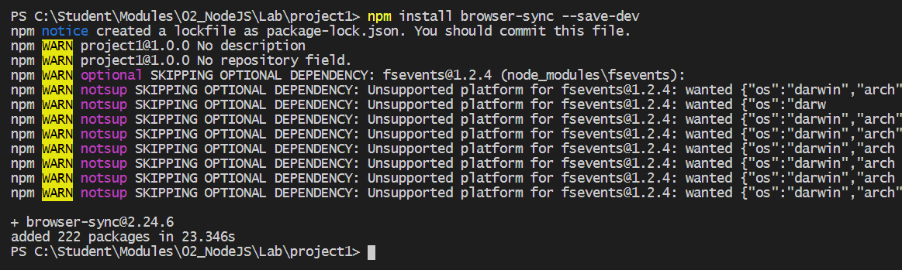
Configuring a Server-side Web Server
Node.js does not provide its own web server
Instead, you must install a npm package to provide web server
There are many different packages to choose from
Example packages which provide a web server for testing
http-server
express
Browser-sync (this is the one we will be using)

Slide 17
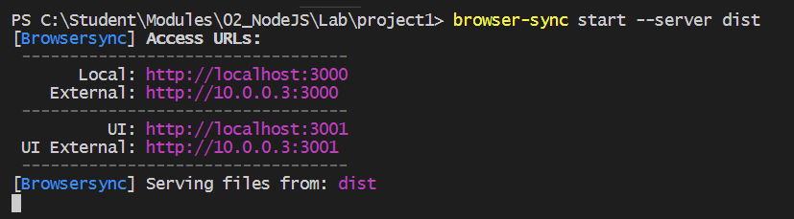
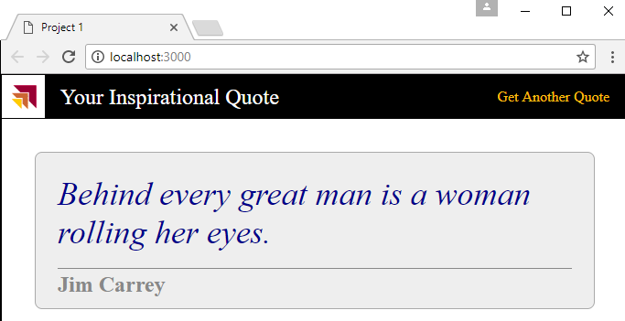
Using browser-sync to Serve Content
browser-sync start command used to start web server
--server parameters references root folder with index.html

Slide 18
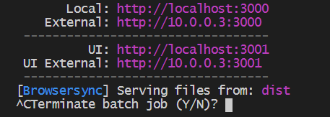
Stopping the Web Server Session
Type CTRL + C into console to interrupt session

Slide 19
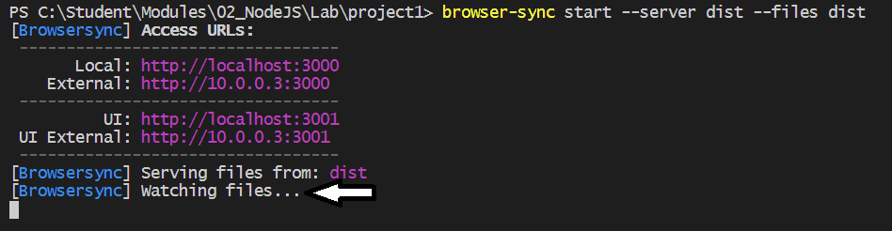
Starting Browser-sync with File Watching
Browser-sync support --files parameter
browser-sync start --server dist --files dist

Slide 20
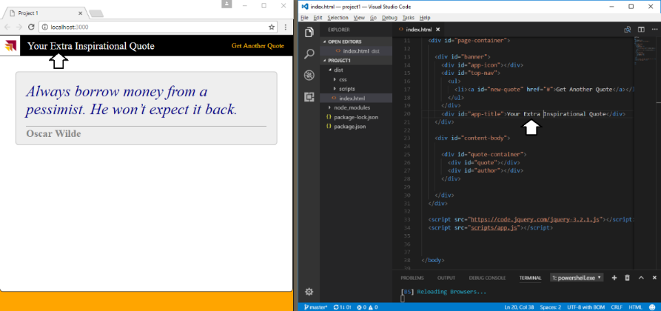
Automatic Updates

Slide 21
Agenda
Introduction to Node.JS and Visual Studio Code
Installing and Updating NPM packages
Configuring Server-side Debugging Support
Node.JS Development with TypeScript
Using Gulp to Automate Running Tasks
Bundling the Source Files using WebPack

Slide 22
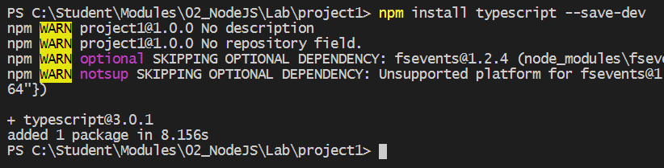
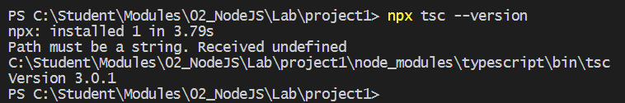
Installing the TypeScript Package
typescript package must be installed into project
Installed just like any other npm package
Take note of version number of typescript package
typescript version may vary from one project to another
Determine project-specific version using npx tsc --version

Slide 23
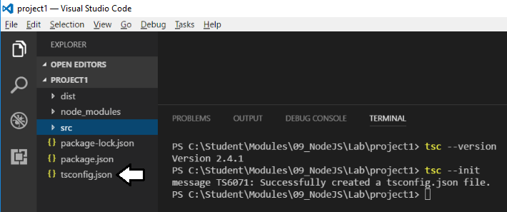
Generating tsconfig.json
Typescript compilation controlled using tsconfig.json file
Generated using tsc --init command

Slide 24
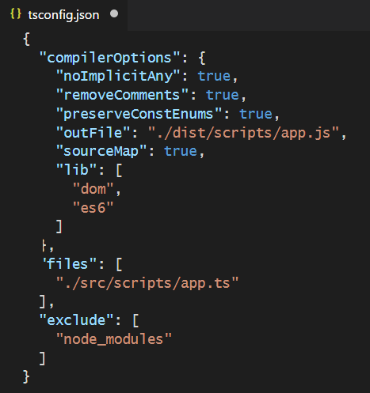
tsconfig.json
Example of a tsconfig.json file

Slide 25
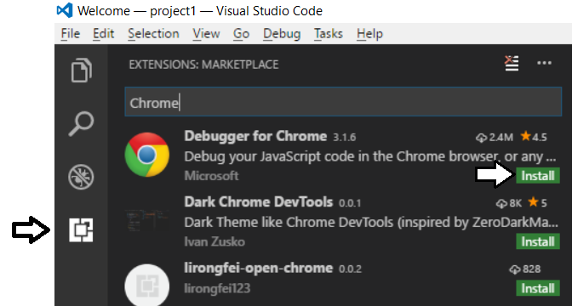
Chrome Debugging Support
Visual Studio Code provides Chrome debugger extension
Provides ability to debug client-side Typescript code

Slide 26
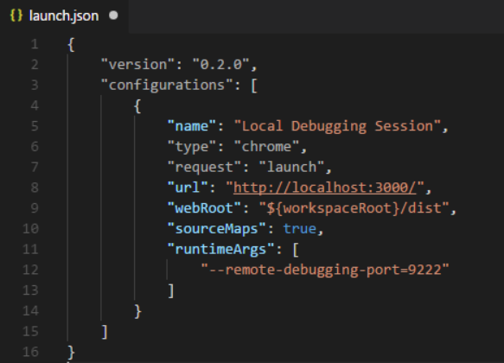
Visual Studio Debugging Support
Debugging configurations tracked in launch.json

Slide 27
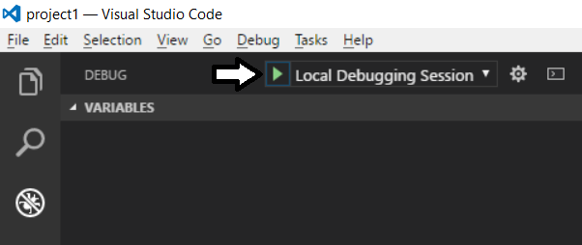
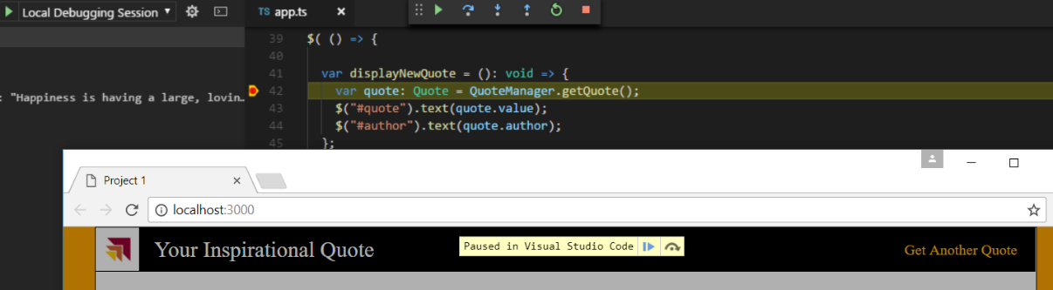
Running the Debugger

Slide 28
Agenda
Introduction to Node.JS and Visual Studio Code
Installing and Updating NPM packages
Configuring Server-side Debugging Support
Node.JS Development with TypeScript
Using Gulp to Automate Running Tasks
Bundling the Source Files using WebPack

Slide 29
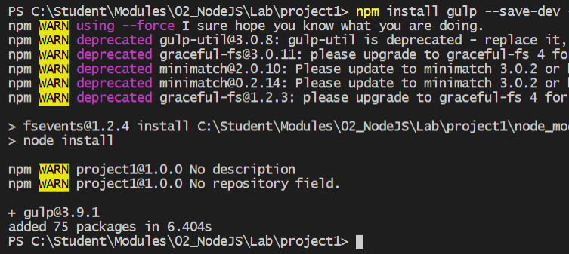
Gulp as a Task Runner
Gulp serves as a Task Runner
Compiles TypeScript files to JavaScript
Compiles SASS files to CSS
Bundles and minifies JavaScript and CSS files

Slide 30
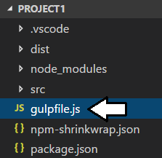
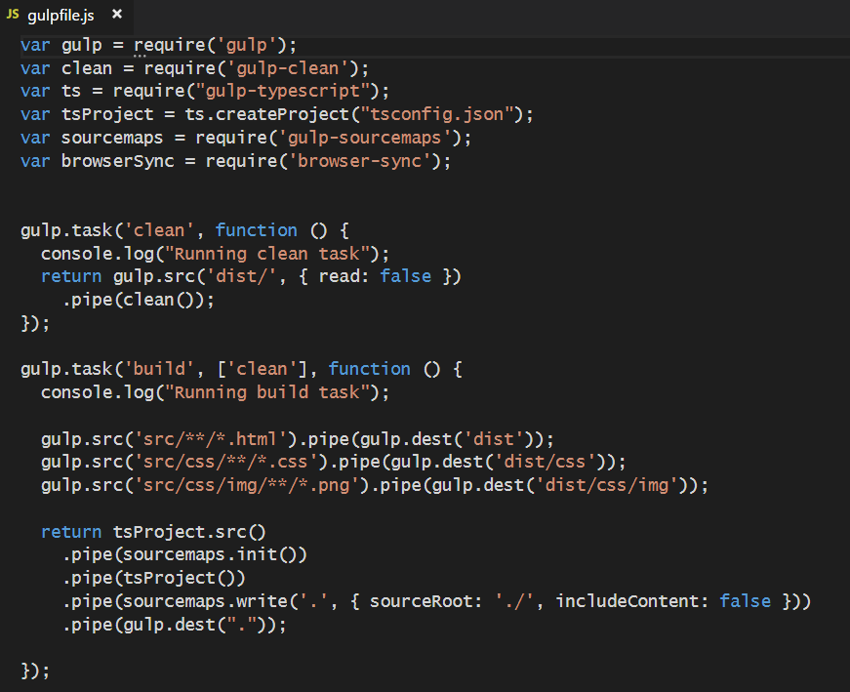
gulpfile.js
Gulp tasks are programmed inside gulpfile.js
Gulpfile.js must be added to root of project

Slide 31
Agenda
Introduction to Node.JS and Visual Studio Code
Installing and Updating NPM packages
Configuring Server-side Debugging Support
Node.JS Development with TypeScript
Using Gulp to Automate Running Tasks
Bundling the Source Files using WebPack

Slide 32
WebPack
WebPack serves as a bundling utility
Bundles many js/ts files into a single file
Can handle dynamic module loading
Provides a dev server for testing and debugging
When using Webpack 4
Install packages for webpack and webpack-cli
npm install webpack webpack-cli --save-dev

Slide 33
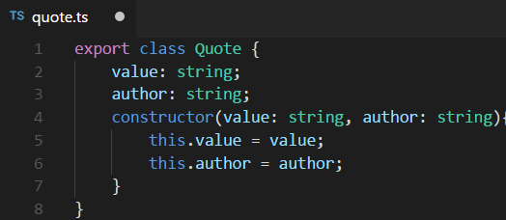
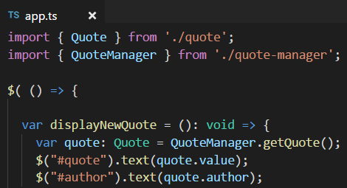
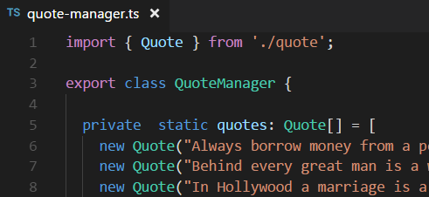
Dynamic Module Loading
Webpack controls dynamic module loading
Your project just references app.ts
Compiler dynamically determines other files to include

Slide 34
Webpack Loaders
Loaders do two things
Identify which file or files should be transformed
Transform files and ad them to dependency graph
Example loaders
awesome-typescript-loader
style-loader
css-loader
url-loader

Slide 35
Webpack Plugins
Webpack supports plugins in addition to loaders
commonly used to perform actions and custom functionality
Plugins act upon compilations or chunks of your bundled modules
Examples Plugins
clean-webpack-plugin
copy-webpack-plugin
html-webpack-plugin

Slide 36
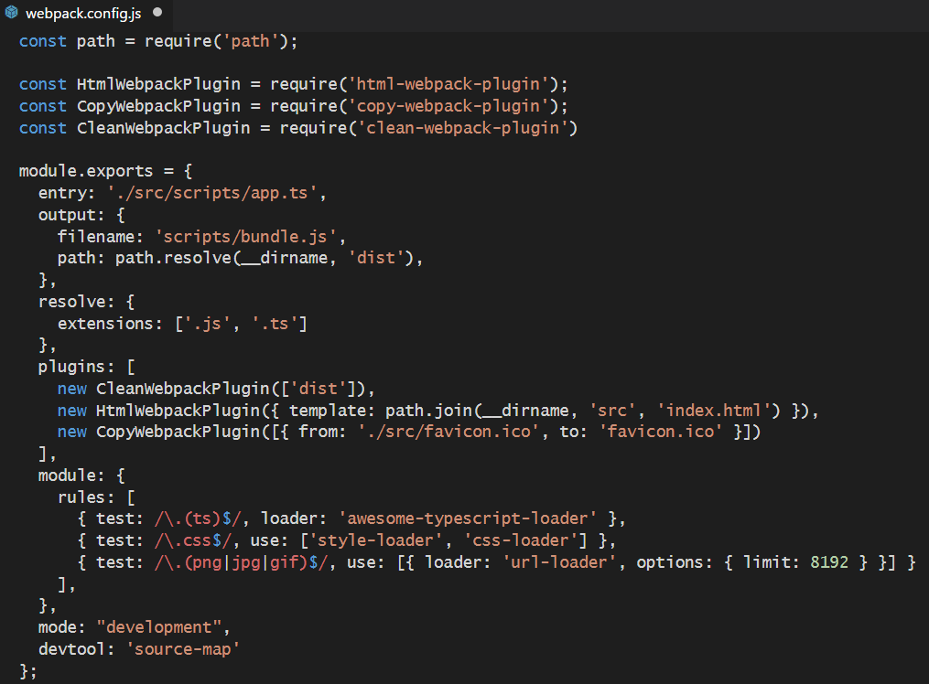
webpack.config.js
Build process controlled through webpack.config.js

Slide 37
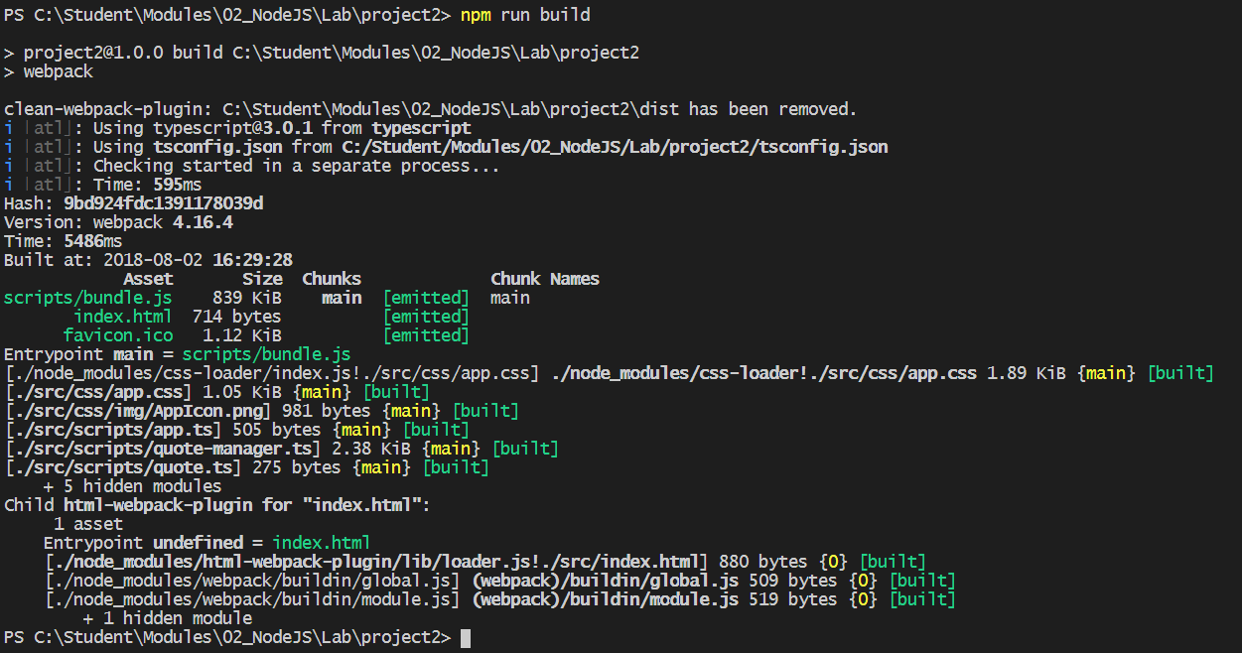
WebPack Builds
Running build process generates files for distribution

Slide 38
Webpack Dev Server
Webpack provides its own development server
Install the webpack dev server package
npm install webpack-dev-server --save-dev
Run your project using the webpack dev server CLI
webpack-dev-server --open

Slide 39
Summary
Introduction to Node.JS and Visual Studio Code
Installing and Updating NPM packages
Configuring Server-side Debugging Support
Node.JS Development with TypeScript
Using Gulp to Automate Running Tasks
Bundling the Source Files using WebPack

